Slide 1
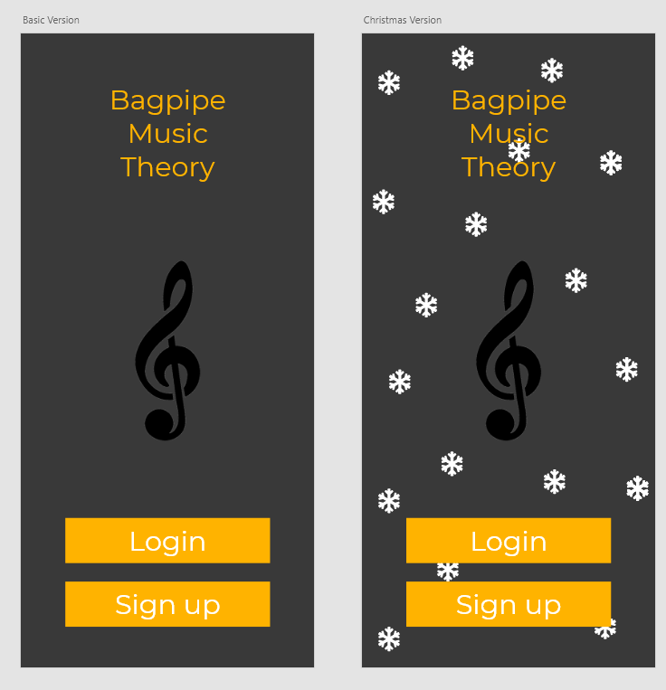
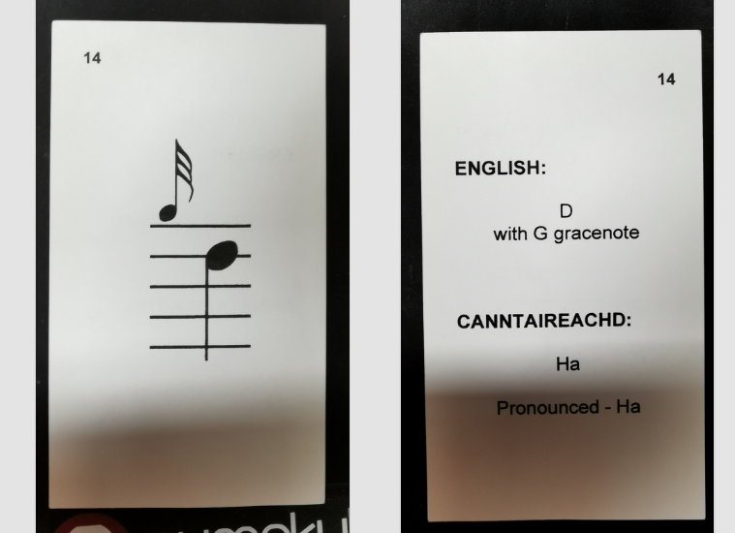

Bagpipe Music Theory Application Prototype
Online Platform Friendly, teaching made easy!
Lewis Maitland & Yang Jiang
Introduction
Figures and Results
Conclusion
Everyone wishes to learn, whether it is a new language, new skill or something that would boost their ability to live their life better. Applications were developed to enhance this need for online learning of new languages and learning musical instruments for the following, English, French, German or Guitar, Piano and even Singing. Focusing on individual words, phrases and notes. One instrument, which is fairly popular around the world, which does not have a huge online Prescence as stated “it is simplify too difficult to fully learn online”.
Bagpipe Music Theory.
From the complicated language surrounding it of Canntaireachd, change of key from other instruments and even time differences with multiple embellishments, which all can be played from 9 notes. Only passed down from generation to generation, teacher to student, the Musical Theory of Bagpipes is a tricky subject for beginners and experienced players which is hard to master. This application/game will fill the online gap in the market to bring a simple guide to learning Bagpipe Music Theory.
On further testing of the application, various survey's were carried out and send across the world. These were ANOMONUS to ensure that the individuals data was safe. The information from these surveys allowed the development of the application to continue, prioritising what was suggested by the participants in relation to what was said about similar applications.
All survey questions and answers will not be shown here due to GDPR reasons and for quality control. Based on comments made by the Users on other applications, all comments were derived by the importance of colour theory, design choice, clarity in pronunciation and the depth of field in how the application can verify how it achieve success. From the way of teaching individuals and their own teaching styles, to giving clear instructions to individuals who need extra assistance.
The full application, is currently in a beta stage of both development and design. With creating the application, so much time was needed to research the best possible way to both test and create it. Since, similar applications about language learning development exist in the market. Ensuring that the design, sound and game style is different from these similar applications, extensive research was needed. This application will continuously evolve through time, to ensure its users can feel more involved with the application and gain more interest into the meaning behind it. Features will include, links to social media and themes surrounding different holidays.
As a result of the continuous development of the application, design structure, sound production and video quality has allowed the application to reach all new heights. The development from basic elements using Adobe XD to now the key components in Unity 2D games/application development, has ensured that the product will maintain its standards. Therefore, will ensure that the aim of creating an application to teach individuals how to learn musical theory will be a success.
The design of the application, how it currently works within the testing phases reflects on the research taken from the comments of both the participants from the surveys and continual development based upon the literature review. Full focus on the way the application has been developed and whether it will work for the target demographic and target audience, currently still in it’s beta stage, the application will allow users to enjoy the simplistic teaching style of learning Musical Notation, Theory behind the music and the complicated language of Canntaireachd.
The ability of choice is a key factor raised in the research and survey questions for the application. Allowing users to chose how they can be taught, toggle between classes and continually learn to either improve their score or build there own confidence up which is the main purpose of the application.
Project Aim
Acknowledgments
Creating an application/game that allows users to effectively learn Bagpipe Music theory. From the complicated singing method of Canntaireachd, a form of how bagpipers would learn their music. As well as, learning sheet music through continuous learning, compared to flash card learning.
The game is still in development and will be until the right amount of development is needed for the application to work globally. As in, ensuring that the application works with different Languages, cultures, and other pipe bands. The designs and sounds implemented in the application may be edited or changed varying on design trends and appealing to other companies, schools or pipe bands. All sounds, designs and elements were created and implemented as their own unique elements, created for the purposes of this application.
Methods
Within the building of the application, the steps to building and achieving this goal was to create a simple platform based on a Flash Card method used to teach for generations. This method, was incorporated into the process of learning each individual not one stage at a time, then practicing each not continuously, with the given prompts.
References
All Images are created for the application based on Trial Phases and Design stages of the application on Adobe XD. All images are based on the current design trends and may not be fully displayed in the main game.
CM4105: Honours Projects

